Slide 1
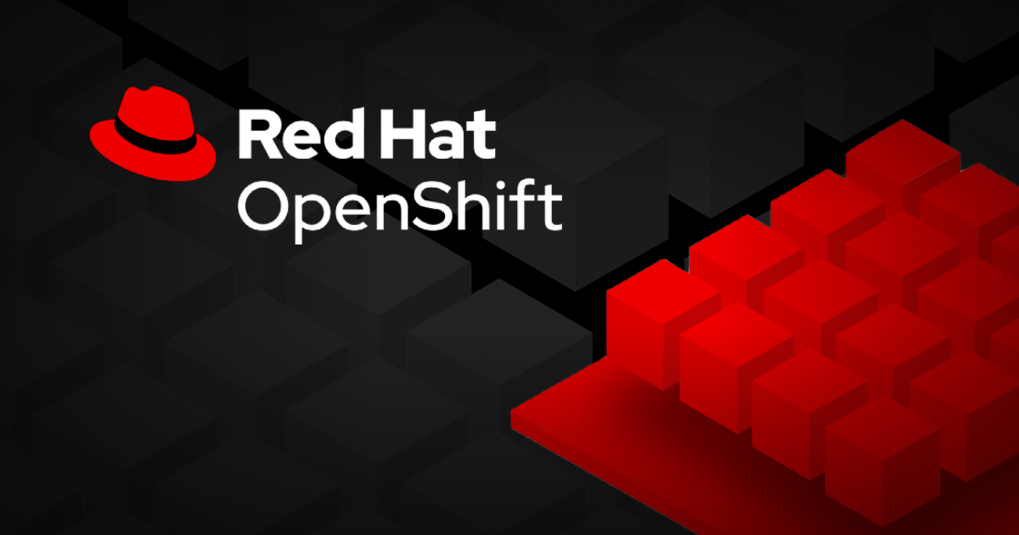
7. Manage Application Updates

Slide 2
Container Image Identity and Tags
1. Image Composition: A container image name consists of a registry, namespace, name, and tag (e.g., registry.access.redhat.com/ubi9/nginx-120:1-86).
• Registry: Source of the image (e.g., registry.access.redhat.com).
• Namespace: Category or organization (e.g., ubi9).
• Name: Identifier, can include software version (e.g., nginx-120 for Nginx v1.20).
• Tag: Refers to a specific image version (e.g., 1-86).
2. Floating vs Static Tags:
• Floating tags like latest point to the most recent image, leading to potential unnoticed updates.
• Static tags ensure consistency, pointing to a fixed version.
3. Issues with Floating Tags: Using floating tags (e.g., latest) might lead to unintended application version updates, especially during scaling or pod relocation.
4. Best Practices: To avoid version inconsistencies, use static tags or the SHA Image ID for guaranteed immutability. Example of SHA ID: name@sha256:....
5. Retrieving SHA ID: Use oc image info to get the SHA ID for a specific image tag.

Slide 3
Container Image Identity and Tags
6. Pull Policies:
• IfNotPresent: Use local image if available; pull only if not present.
• Always: Always check for a new version.
• Never: Do not pull, assuming the image is pre-loaded on the node.
7. Image Pruning:
• Images remain on nodes after pod deletion for reuse.
• OpenShift’s garbage collector removes unused images if disk usage exceeds 85%.
• One can manually inspect or prune images using crictl, though it’s recommended to rely on the garbage collector for automatic cleanups.

Slide 4
Update Application Image and Settings
1. Application Separation: Application code, settings (configurations), and data are kept separate. OpenShift uses config maps, secrets, and volumes to manage these settings and data.
2. Updating Code: To update an app’s code, one needs to build a new container image. This is often automated using a CI/CD pipeline, which builds and pushes the new image to a registry.
3. Deployment Strategies:
• Rolling Update (default):
• Updates the app one part at a time, keeping it running during the update.
• Both old and new versions may run together temporarily.
• Use readiness probes to ensure new versions are ready before they get traffic.
• Recreate:
• Stops the app completely before starting the new version.
• Causes downtime, best for apps that cannot run two versions at once.
4. Handling Multiple Changes: Pause the app’s deployment using oc rollout pause, make all the updates, then use oc rollout resume to apply everything at once and avoid multiple updates.
5. Managing Pods: OpenShift uses ReplicaSets to manage pods (instances of your app). When the app is updated, it creates a new ReplicaSet for the new version while keeping old ones.

Slide 5
Update Application Image and Settings
6. Rolling Back: One can revert to an older version of the app using oc rollout undo. OpenShift keeps older versions stored as ReplicaSets.
7. Monitoring Rollouts:
• Check how the app is updating with oc rollout status.
• Use oc rollout history to see previous app versions and even roll back to a specific one if needed.

Slide 6
Reproducible Deployments with OpenShift Image Streams
1. Image Streams Overview:
• OpenShift uses image streams to manage and reference container images, unlike Kubernetes, which references images directly. This allows OpenShift to ensure reproducible and stable deployments, as well as easy rollbacks.
• Image streams let you reference images with a simple, stable name, even if the registry or image changes.
2. Benefits of Image Streams:
• Image streams help track different versions of container images, ensuring that updates or changes to an image don’t automatically affect deployments unless one want them to.
• If an image in a registry is updated or replaced, the image stream lets you roll back to the previous working version if needed.
3. Image Stream Tags:
• Image streams use tags to manage different versions of an image. Each tag refers to a specific image version and stores metadata about it for faster retrieval and inspection.
• Tags can point to images from different sources (registries), giving flexibility to switch between vendors or versions without affecting deployment names.
4. Reproducibility:
• Image streams ensure that new instances of an app always use the same image version by storing the exact image ID (SHA). This prevents new pods from accidentally using a newer version of an image.

Slide 7
Reproducible Deployments with OpenShift Image Streams
5. Updating Image Streams:
• To update image stream tags, use the oc tag command, which points the image stream tag to a new image.
• Configure image streams to check for updates periodically by using the –scheduled option, making sure app always uses the latest image from trusted sources.
6. Caching and Local Lookup:
• Cache images locally in OpenShift’s internal registry to speed up pulls and avoid issues with slow networks or registry outages. Use –reference-policy local to enable this.
• When deploying with image streams, enable local lookup so OpenShift looks for images in the image stream before checking external registries.
7. Using Image Streams in Deployments:
• When creating a deployment, reference the image stream by its tag (e.g., keycloak:20.0) instead of using the full image name. This ensures OpenShift uses the correct image from the stream.
• Image streams can also be used with other resources like jobs, cron jobs, and pods.

Slide 8
Automatic Image Updates with OpenShift Change Triggers
1. Image Triggers for Automatic Updates:
• Image stream tags track the version of an image using a unique SHA ID. When one updates an image stream tag to a new version, OpenShift won’t automatically redeploy unless one use image triggers in the Deployment object.
2. Configuring Image Triggers:
• Ensure Deployment object uses image stream tags (e.g., keycloak:20 instead of full image names). Use the command
oc set triggers deployment/mykeycloak --from-image keycloak:20 --containers keycloak
3. Deployment Objects:
• Deployment objects in OpenShift don’t natively support image stream tags like DeploymentConfig does, but OpenShift adds special annotations to track changes and roll out updates automatically.
4. Managing Triggers:
• One can disable automatic triggers using the command:
oc set triggers deployment/mykeycloak --manual --from-image keycloak:20 --containers keycloak
• To re-enable, use:
oc set triggers deployment/mykeycloak --auto --from-image keycloak:20 --containers keycloak

Slide 9
Automatic Image Updates with OpenShift Change Triggers
5. Rolling Back Deployments:
• If a new image doesn’t work, for Deployment objects, one can’t use the rollback command. Instead, one needs to reset the image stream tag to the previous version to trigger the rollback.
6. Creating and Updating Image Stream Tags:
• Create image stream tags using commands like:
oc create istag keycloak:20.0 --from-image quay.io/keycloak/keycloak:20.0.2
7. Testing and Updating Tags:
• After testing a new image, move the tag (e.g., keycloak:20) to the new image version to roll out updates:
oc tag --alias keycloak:20.0.3 keycloak:20

Slide 10
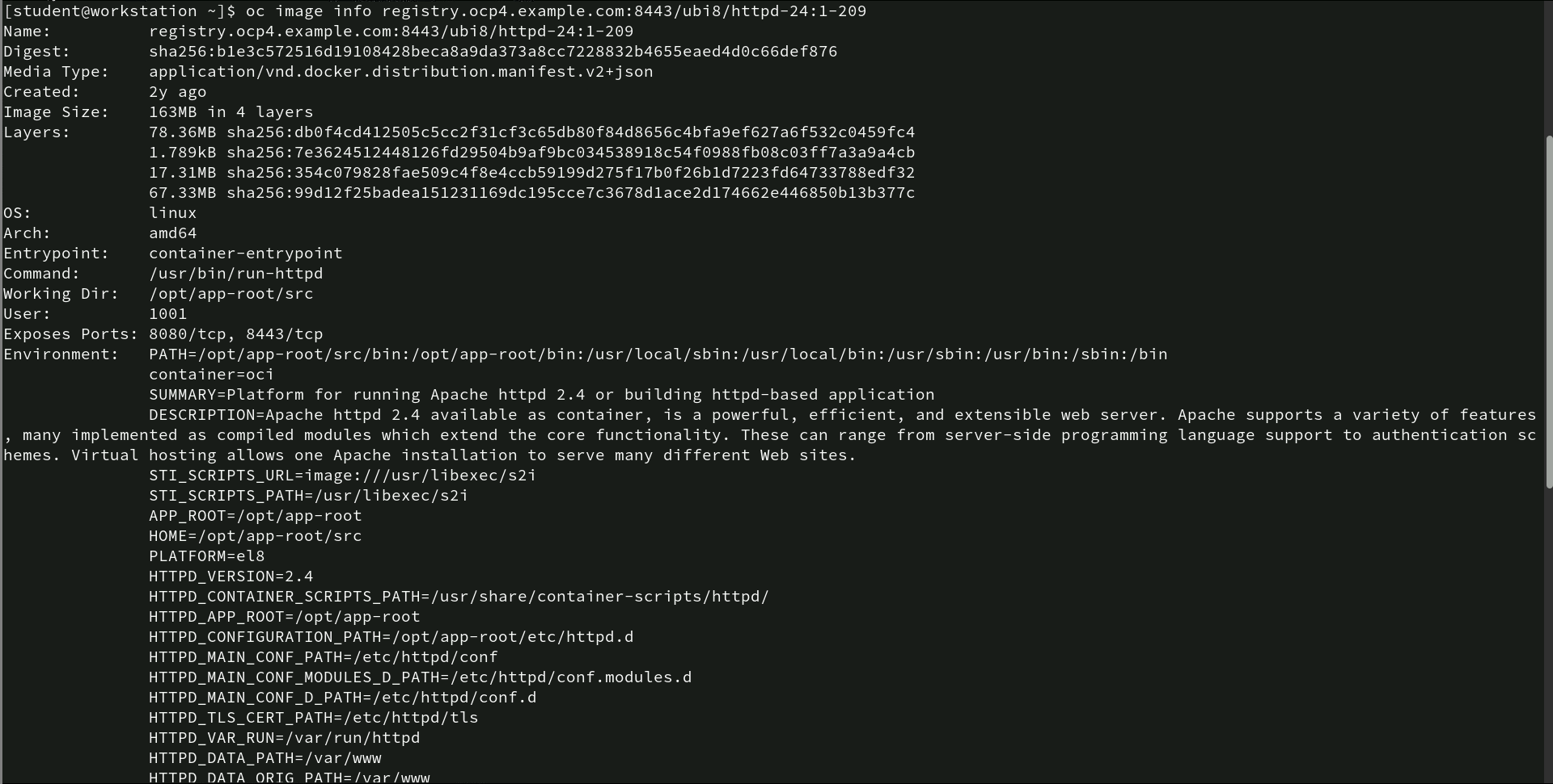
Image Information for container Image
oc image info registry.ocp4.example.com:8443/ubi8/httpd-24:1-209: This command retrieves detailed information about a container image stored in a container registry using OpenShift’s oc command-line tool.
Key features-
The image registry.ocp4.example.com:8443/ubi8/httpd-24:1-209 is an Apache HTTP server version stored in a container registry. It is identified by digest sha256:b1e3c57251d619108428ce8a9da37a8cc7228832b4655eaed4d0c66def876 and follows Docker’s distribution spec v2. The image, created 2 years ago, is 163 MB in size and runs on Linux (amd64). It executes /usr/bin/run-httpd as the main process under user ID 1001 and exposes ports 8080 (HTTP) and 8443 (HTTPS). It has several environment variables set, including paths for HTTPD configuration and S2I scripts, and runs with non-root security.

Slide 11
Logging into a container Image Registry Using Skopeo
skopeo login registry.ocp4.example.com:8443 -u developer -p developer: The command in the screenshot uses skopeo to log in to a container image registry at registry.ocp4.example.com:8443. It specifies a username (-u developer) and a password (-p developer) to authenticate. Upon successful login, it outputs “Login Succeeded!”. This indicates that the credentials were correct, allowing the user to interact with the registry for actions like pulling or pushing images.

Slide 12
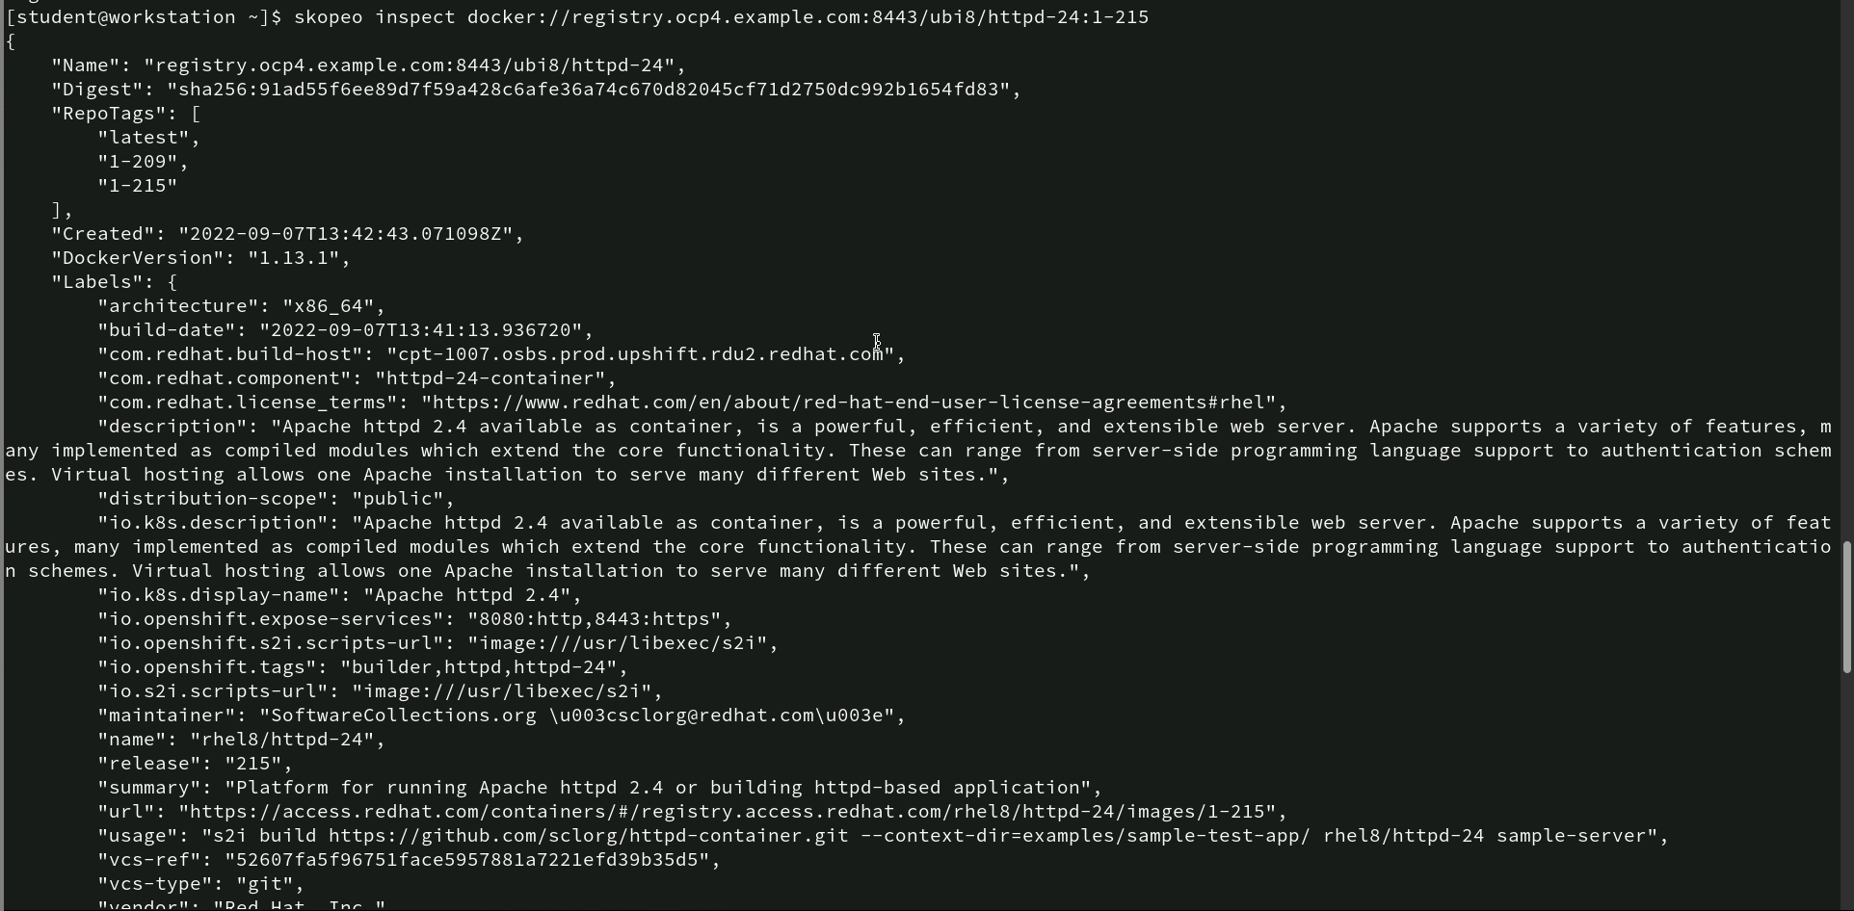
Inspecting Docker Image Using Skopeo
- skopeo inspect docker://registry.ocp4.example.com:8443/ubi8/httpd-24:1-215: This command inspects a Docker image stored in a remote container registry (registry.ocp4.example.com:8443). It retrieves and displays detailed metadata about the image, including information like tags, creation date, architecture, labels, and exposed services. This is useful for understanding the image’s properties before using it.

Slide 13
Inspecting Docker Image Using Skopeo
Key Output Details:
• Registry: Hosted at registry.ocp4.example.com:8443.
• Image: ubi8/httpd-24 with tag 1-215.
• Tags: latest, 1-209, 1-215.
• Docker Version: 1.13.1.

Slide 14
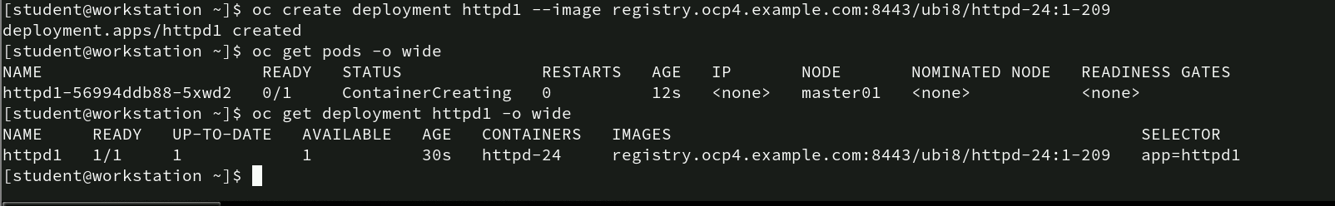
Creating and verifying OpenShift Deployment
oc create deployment httpd1 --image registry.ocp4.example.com:8443/ubi8/httpd-24:1-209: This command creates a new deployment named httpd1 in OpenShift using the specified image (ubi8/httpd-24:1-209) from the remote registry. It sets up a pod to run the Apache HTTP server.
oc get pods -o wide: This command retrieves information about the pods, displaying details like pod status, readiness, and node assignment. Here, the pod is in ContainerCreating status, meaning the container is still being set up.
oc get deployment httpd1 -o wide : This command fetches detailed information about the deployment httpd1, showing its readiness, available replicas, and the associated container image. The output indicates that the deployment is up-to-date with 1 pod running the Apache HTTP server (httpd-24).

Slide 15
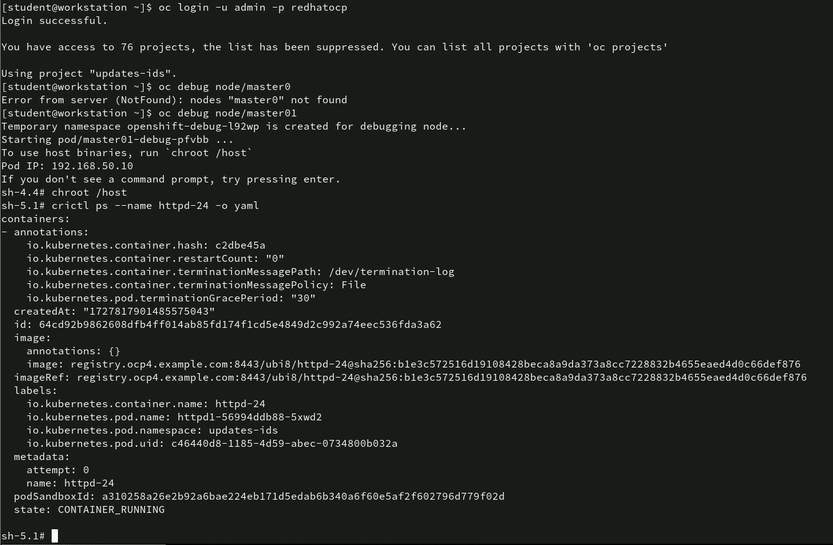
Debugging a Node and Inspecting Container Information in OpenShift
- oc debug node/master01: Starts a debug pod on the node master01 for troubleshooting and running diagnostic commands. The debug pod allows for privileged access, mimicking the node environment.
- chroot /host: Changes the root directory to /host, which enables access to the node’s file system from within the debug pod.
- crictl ps --name httpd-24 -o yaml: Lists detailed information about the container named httpd-24 in YAML format. The output includes metadata like container ID, image details, annotations, and labels related to the running container.

Slide 16
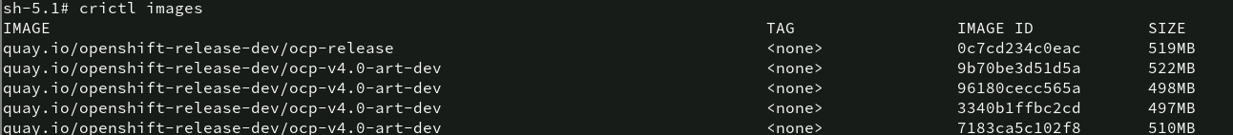
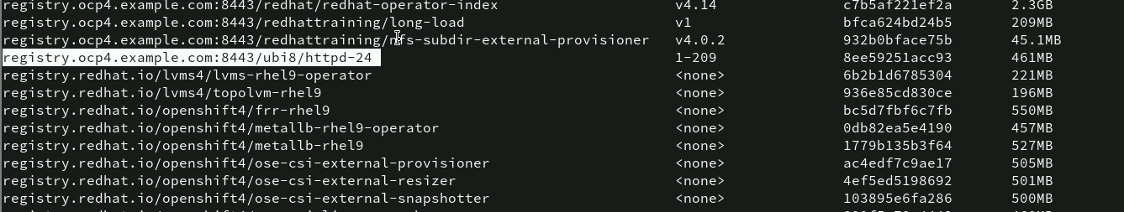
Listing Container Images Using crictl
crictl images: This command lists all container images available on the system using the crictl tool. The output displays the image repository (quay.io/openshift-release-dev), image ID, size, and the tag (in this case, <none> as no specific tag is associated with these images). Each image varies slightly in size, ranging from 497MB to 522MB, which helps identify the storage consumed by each image. This command is useful for inspecting the images available locally on the node for debugging or operational tasks

Slide 17
Viewing Specific Container Image by Digest
crictl images --digests 8ee59251acc93: This command filters the list of container images based on the digest 8ee59251acc93. It displays information about the specific image associated with this digest. In this case, the image is from the registry registry.ocp4.example.com:8443/ubi8/httpd-24 with tag 1-209. The image ID matches the specified digest, and its size is 461MB. This command is useful for verifying image integrity or retrieving image details based on its digest.

Slide 18
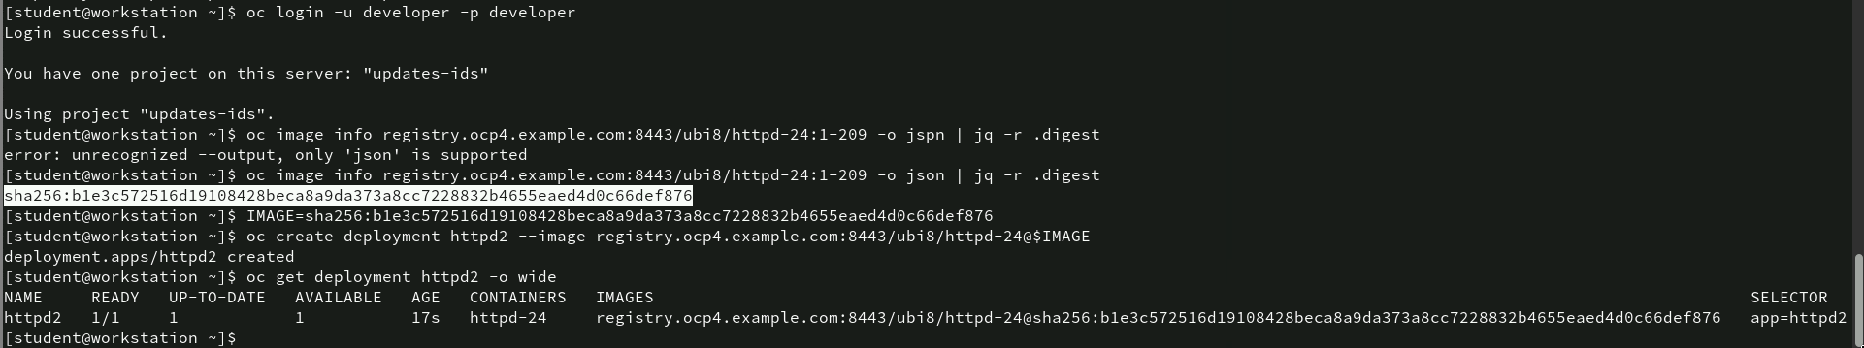
Creating and OpenShift Deployment with a Specific Image Digest
oc image info registry.ocp4.example.com:8443/ubi8/httpd-24:1-209 -o json | jq -r .digest: Retrieves the digest of the image ubi8/httpd-24:1-209 from the registry, formatting the output as JSON, and extracts just the digest value using jq.
IMAGE=sha256:ble3c572516d1910842beca8a9da373a8cc7228832b4655eaed4d0c66def876: Sets the image digest as an environment variable (IMAGE) for later use in creating a deployment.
oc create deployment httpd2 --image registry.ocp4.example.com:8443/ubi8/httpd-24@$IMAGE: Creates a new deployment named httpd2 using the image from the registry (ubi8/httpd-24) and its digest, ensuring the exact version of the image is deployed.
oc get deployment httpd2 -o wide: Retrieves detailed information about the newly created httpd2 deployment, showing that it has one ready pod using the specified image.

Slide 19
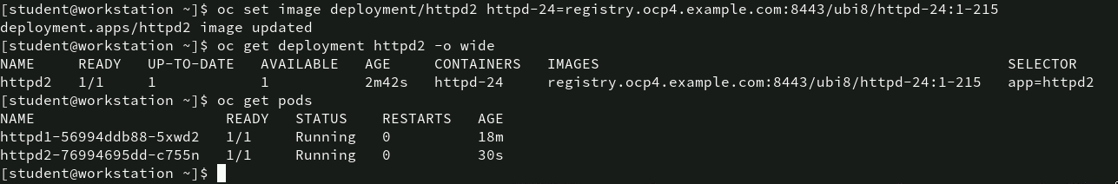
Updating Deployment Image
oc set image deployment/httpd2 httpd-24=registry.ocp4.example.com:8443/ubi8/httpd-24:1-215: Updates the image used by the httpd2 deployment to a new version (ubi8/httpd-24:1-215). This ensures that the deployment is now using the updated container image from the specified registry.
oc get deployment httpd2 -o wide: Retrieves detailed information about the httpd2 deployment, showing that the deployment is up-to-date with 1 pod running the updated image (ubi8/httpd-24:1-215).
oc get pods: Lists all running pods in the current project, showing that both httpd1 and httpd2 are running. httpd2 has been running for 30 seconds, indicating that the pod was recently created with the updated image.

Slide 20
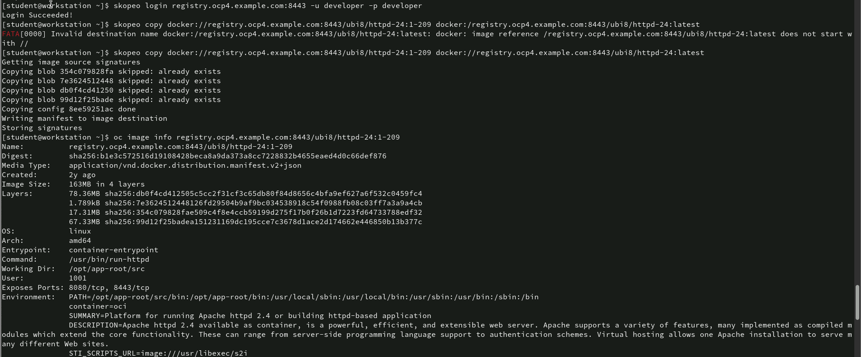
Copying and Inspecting an Image Using Skopeo and OpenShift
skopeo copy docker://registry.ocp4.example.com:8443/ubi8/httpd-24:1-209 docker://registry.ocp4.example.com:8443/ubi8/httpd-24:latest: Copies the image ubi8/httpd-24:1-209 from the registry and retags it as latest. This ensures the latest tag points to the correct image. The error in the first command indicates a misconfiguration, but the corrected version works as expected.
oc image info registry.ocp4.example.com:8443/ubi8/httpd-24:1-209: Retrieves detailed information about the image ubi8/httpd-24:1-209, including its digest, layers, architecture, size (163MB), and other metadata such as the exposed ports (8080, 8443) and environment variables. This command provides an overview of the image configuration for verification or troubleshooting.

Slide 21
Retrieving Basic Information for an OpenShift Image
oc image info registry.ocp4.example.com:8443/ubi8/httpd-24:latest | head -2: This command retrieves basic information about the image ubi8/httpd-24:latest from the registry. Using the head -2 command limits the output to the first two lines, displaying only the image name and its digest (sha256:ble3c572516d...). This provides a quick check to verify the image’s identifier and digest, which can be useful for ensuring you’re working with the correct image versio

Slide 22
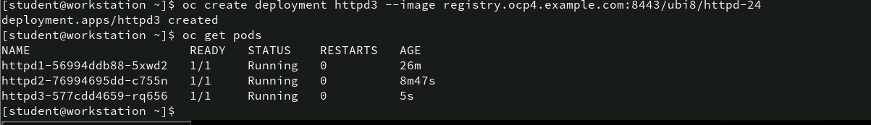
Configuring a Deployment with Startup Probes in Openshift
oc create deployment httpd3 --image registry.ocp4.example.com:8443/ubi8/httpd-24: This command creates a deployment named httpd3 using a specified HTTPD image from the registry. The deployment will manage the HTTPD pod.
oc get pods: This command retrieves and lists all the running pods, displaying the pod name, readiness status, running state, number of restarts, and the age of each pod.

Slide 23
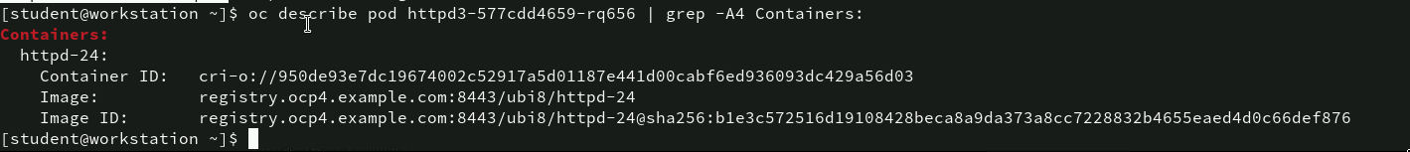
Describing Pod and Container Information
oc describe pod httpd3-577cdd4659-rq656 | grep -A4 Containers: This command describes the pod httpd3-577cdd4659-rq656 and uses the grep command to filter for the section containing “Containers” and the next 4 lines of output (-A4). The output shows details such as the container ID, image, and image ID associated with the httpd3 pod. The image is being pulled from registry.ocp4.example.com:8443/ubi8/httpd-24, and the container’s image ID is shown with a specific SHA-256 hash.

Slide 24
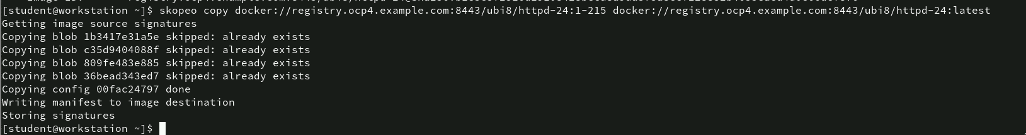
Copying Image Using Skopeo
skopeo copy docker://registry.ocp4.example.com:8443/ubi8/httpd-24:1-215 docker://registry.ocp4.example.com:8443/ubi8/httpd-24:latest: This command copies the image from one tag (1-215) to another tag (latest) within the same image repository. Skopeo is a tool that allows for copying container images between different registries, filesystems, and storage systems. In this case, the output shows that several layers of the image blobs are skipped, indicating they already exist, meaning they don’t need to be copied again. The copying process completes successfully with the message “Writing manifest to image destination” and “Storing signatures.”

Slide 25
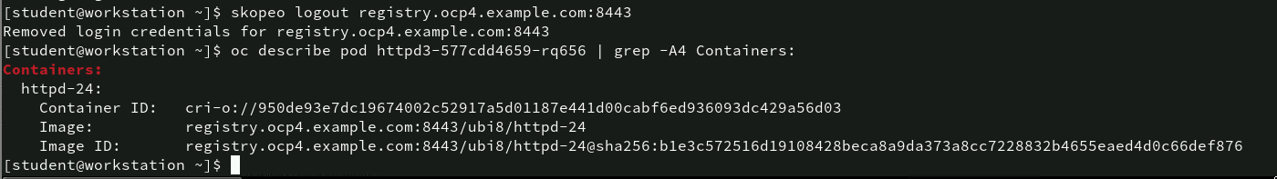
Logging out and Describing the Pod details
oc describe pod httpd3-577cdd4659-rq656 | grep -A4 Containers: : this describes the httpd3 pod and filters for container-related information. It provides the container ID, image, and image ID for the running HTTPD container. The details confirm that the pod is still referencing the correct image from the registry, even after the user logged out of the registry.

Slide 26
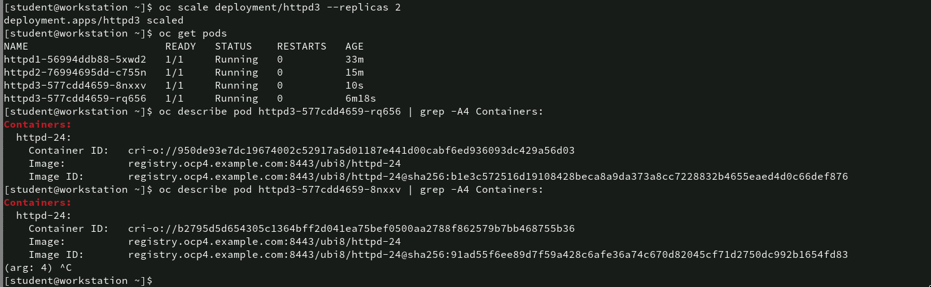
Scaling Deployment and Viewing Pod Details
- oc scale deployment/httpd3 --replicas=2: This command scales the httpd3 deployment, reducing the number of replicas (or instances) to 2. This ensures that only two pods are running for the httpd3 deployment instead of more or fewer pods.
Analysis: The subsequent describe pod commands verify that both pods use the same image, confirming consistency across the scaled deployment. This showcases the flexibility of scaling in OpenShift, allowing the user to manage resources efficiently.

Slide 27
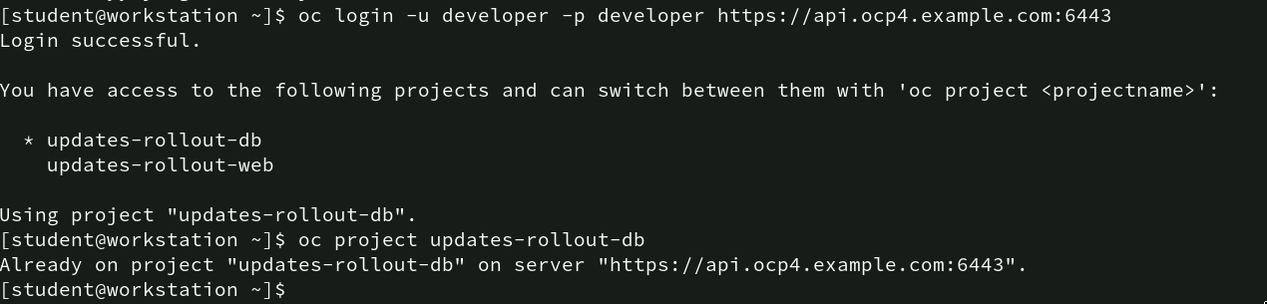
Logging into OpenShift and Switching Projects
The user successfully logs into the OpenShift cluster and confirms access to two projects: updates-rollout-db and updates-rollout-web. By switching to updates-rollout-db, the user ensures that all subsequent commands will operate within the context of this project.

Slide 28
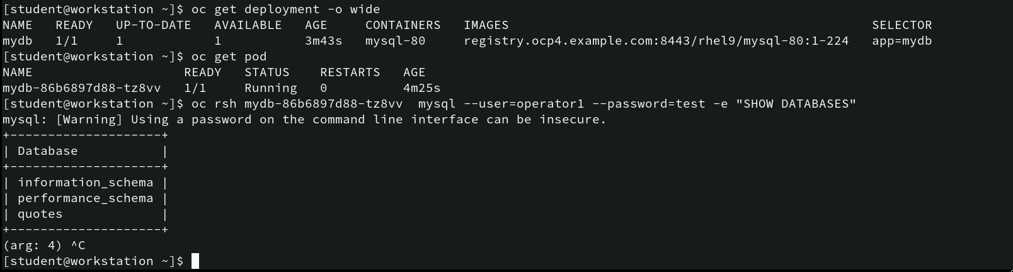
Managing MySQL Deployment and Accessing Databases
- oc rsh mydb-86b6897d88-tz8vv mysql --user=operator1 --password=test -e "SHOW DATABASES”: This command allows the user to execute a remote shell (rsh) into the running MySQL container (mydb-86b6897d88-tz8vv). Inside the container, the user runs a MySQL command with the credentials operator1 and password test to display the available databases using the SHOW DATABASES command.
Analysis: The MySQL deployment and pod are functioning correctly, as indicated by the “Running” state of the pod. The user is able to connect to the MySQL instance via remote shell and successfully list the available databases.

Slide 29
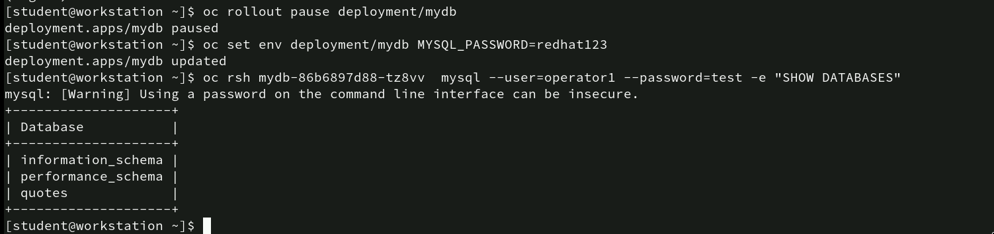
Pausing Rollout, Updating Env variables, and accessing MySQL
oc rollout pause deployment/mydb: This command pauses the rollout for the mydb deployment. This action halts any new updates or changes being applied to the deployment until it is resumed.
oc set env deployment/mydb MYSQL_PASSWORD=redhat123: This command updates the environment variables of the mydb deployment, specifically setting MYSQL_PASSWORD to redhat123.oc rsh mydb-86b6897d88-tz8vv mysql --user=operator1 --password=test -e "SHOW DATABASES”: After updating the environment variable, the user remotely connects to the MySQL instance in the pod again using rsh and lists the databases by running the SHOW DATABASES MySQL command.
Analysis: The pausing of the rollout ensures that no changes are applied until the user confirms everything works as expected. The environment variable update is critical for securely handling credentials, although in this case, the MySQL password change hasn’t been reflected in the rsh command yet (it still uses test).

Slide 30
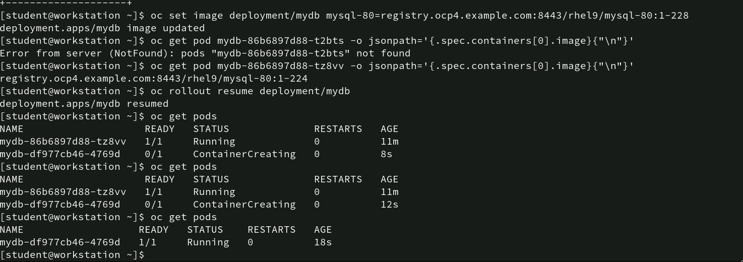
Updating Image and Resuming Deployment
oc set image deployment/mydb mysql-80=registry.ocp4.example.com:8443/rhel9/mysql-80:1-228: This command updates the mydb deployment to use a new image for the mysql-80 container.
oc get pod mydb-86b6897d88-tz8vv -o jsonpath='{.spec.containers[0].image}{"\n"}’: This command successfully retrieves the image information for the pod mydb-86b6897d88-tz8vv, confirming that the pod is using the updated.
oc rollout resume deployment/mydb: This command resumes the rollout of the mydb deployment, which had been paused earlier.
Analysis: The image update and rollout process for the MySQL deployment was successful. The new image is applied, and after resuming the rollout, the pods are correctly recreated and initialized with the updated image. This ensures that the application runs on the latest container image from the registry without issues, confirming a smooth transition to the new version.

Slide 31
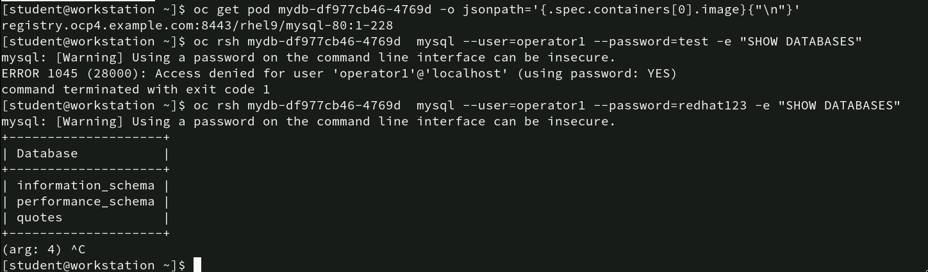
Accessing MySQL with Updated Credentials
oc get pod mydb-df977cb46-4769d -o jsonpath='{.spec.containers[0].image}{"\n"}’: This command retrieves the image used by the pod mydb-df977cb46-4769d.
oc rsh mydb-df977cb46-4769d mysql --user=operator1 --password=redhat123 -e "SHOW DATABASES”: the user is able to list the available databases: information_schema, performance_schema, and quotes.
Analysis: The updated password (redhat123) has been successfully applied to the MySQL environment, allowing access to the database with the new credentials. The previous password (test) was rejected, which indicates that the environment variable update for the password was correctly applied.

Slide 32
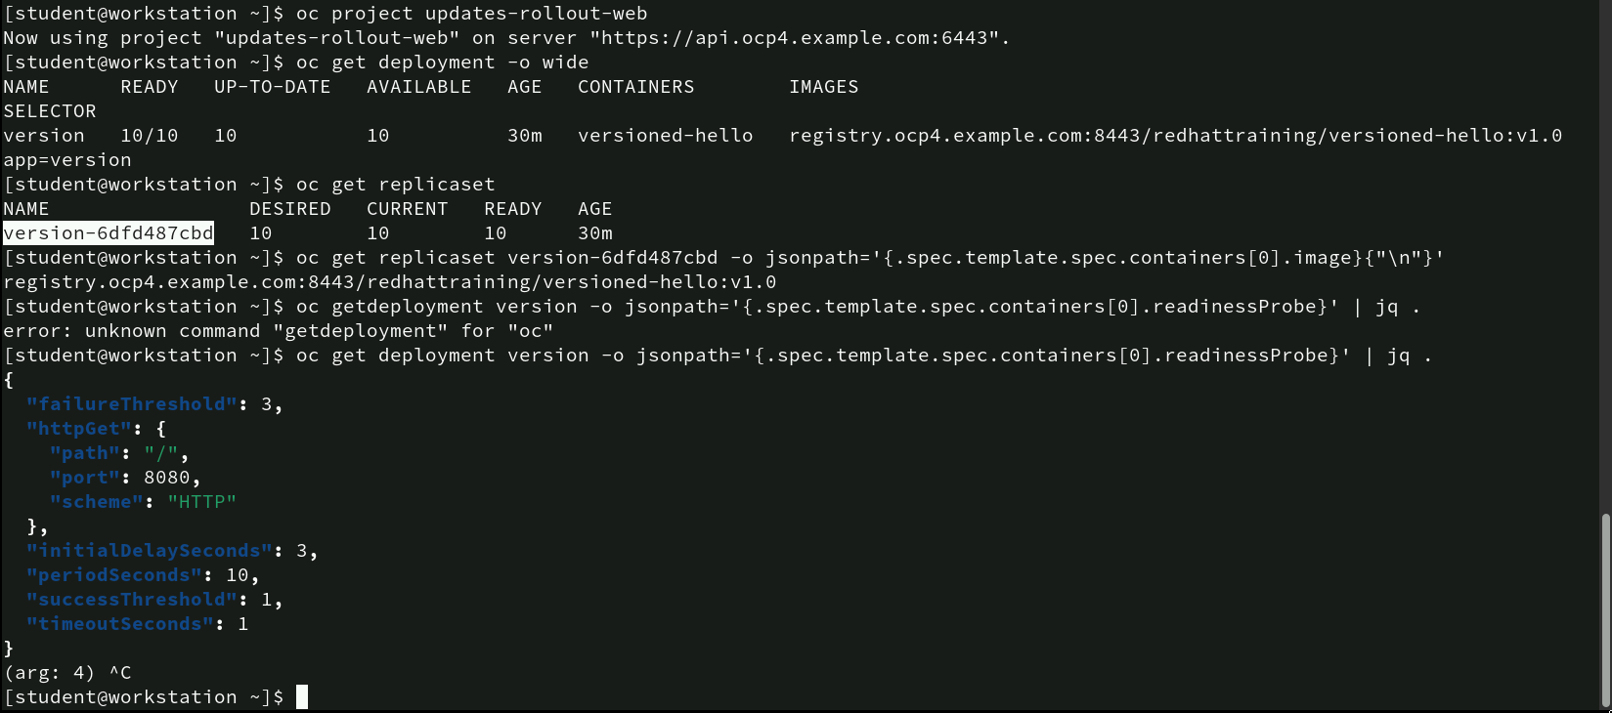
Managing Deployment and Retrieving Probe Information
oc get replicaset: This command lists the replica sets associated with the deployment,
oc get replicaset version-6dfd487cbd -o jsonpath='{.spec.template.spec.containers[0].image}{"\n"}’: This command retrieves the image being used by the replica set version-6dfd487cbd.
oc get deployment version -o jsonpath='{.spec.template.spec.containers[0].readinessProbe}' | jq . : This command retrieves and formats the readiness probe configuration for the version deployment using jsonpath and jq for pretty-printing.
Analysis: The deployment and replica set are functioning properly, with all pods up-to-date and using the correct image. The readiness probe details retrieved show a health check configured for the HTTP endpoint / on port 8080, which helps ensure that the application is ready to receive traffic.

Slide 33
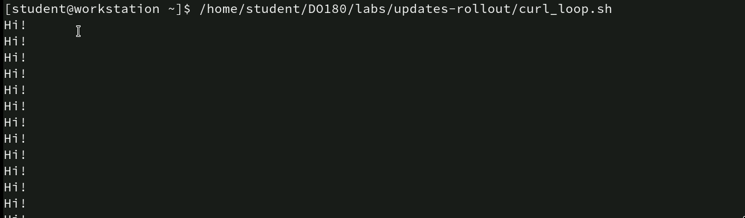
Executing a Curl Loop
/home/student/D0180/labs/updates-rollout/curl_loop.sh: This command runs the script curl_loop.sh, which likely sends repeated curl requests to a specified endpoint.

Slide 34
Updating Deployment Image
oc set image deployment/version versioned-hello=registry.ocp4.example.com:8443/redhattraining/versioned-hello:v1.1: This command updates the image used by the version deployment to a new version (v1.1). The image is pulled from the registry registry.ocp4.example.com, and the deployment is successfully updated with the message “deployment.apps/version image updated.”

Slide 35
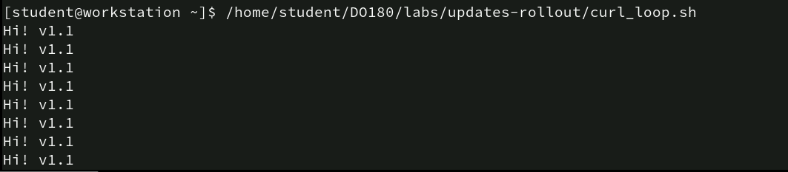
Verifying Service Update with Curl Loop Script
/home/student/D0180/labs/updates-rollout/curl_loop.sh: The output now shows “Hi! v1.1”, indicating that the service is responding with the updated version v1.1, which was set in the deployment image earlier.
Analysis: This confirms that the service has been successfully updated to version v1.1 following the image update. The repeated curl requests to the service show that the application is running the new version without any issues, and the service is consistently returning the updated message.

Slide 36
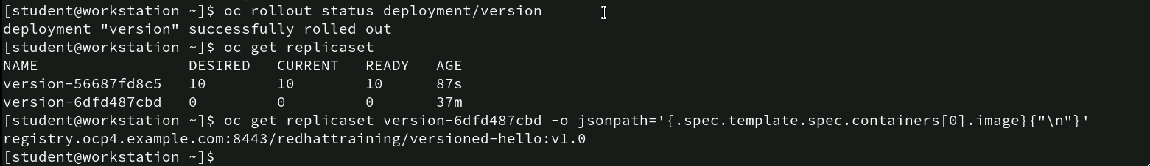
Checking Rollout Status and ReplicaSet Information
oc rollout status deployment/version: This command checks the status of the version deployment.
oc get replicaset: This command lists the replica sets associated with the version deployment.
oc get replicaset version-6dfd487cbd -o jsonpath='{.spec.template.spec.containers[0].image}{"\n"}’: This command retrieves the image used by the older replica set version-6dfd487cbd, confirming that it used the versioned-hello:v1.0 image.
Analysis: The rollout has successfully updated the deployment to use the new version of the image (v1.1), as shown by the newly active replica set version-56687fd8c5. The old replica set (version-6dfd487cbd) has been scaled down to 0 pods, meaning no instances are running from the old version. This confirms a smooth and successful transition to the new version of the service.

Slide 37
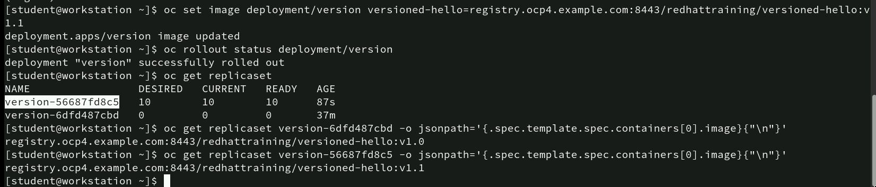
Finalizing Deployment Image Update and Verifying ReplicaSet
oc set image deployment/version versioned-hello=registry.ocp4.example.com:8443/redhattraining/versioned-hello:v1.1: This command updates the version deployment to use the v1.1 image of versioned-hello.
oc rollout status deployment/version: The user checks the rollout status of the deployment, confirming that it was successfully rolled out and the new image is now in use.
oc get replicaset version-6dfd487cbd -o jsonpath='{.spec.template.spec.containers[0].image}{"\n"}'
oc get replicaset version-56687fd8c5 -o jsonpath='{.spec.template.spec.containers[0].image}{"\n"}’: The first command retrieves the image used by the older replica set, confirming it was running versioned-hello:v1.0. The second command retrieves the image used by the active replica set, confirming it is now using versioned-hello:v1.1.
Analysis: The deployment has been successfully updated to use the v1.1 image, as reflected in the new replica set version-56687fd8c5. The old replica set has been scaled down, and all 10 pods are running with the new image.

Slide 38
Rolling Back a Deployment
This command rolls back the version deployment to the previous configuration or image.
Analysis: Rolling back a deployment is useful when an update causes issues or when the user needs to revert to a previous stable version. In this case, the version deployment has been rolled back to the previously used image or configuration, ensuring that the application reverts to the last known working state.

Slide 39
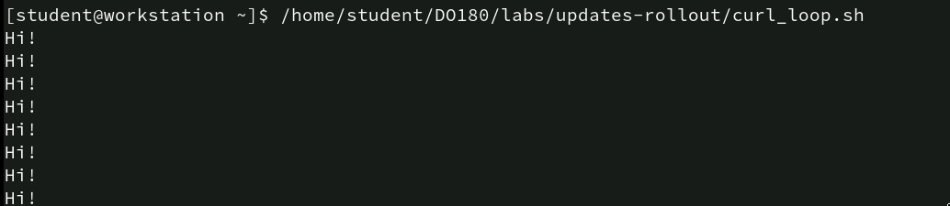
Verifying Rollback with Curl Loop Script
The output shows repeated “Hi!” messages, which likely indicate that the service has been reverted to the previous version, where it responded with just “Hi!” instead of “Hi! v1.1” as seen in earlier runs.

Slide 40
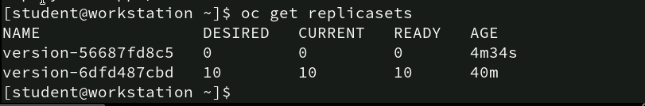
Verifying ReplicaSets After Rollback
This command lists the replica sets for the version deployment. The output shows:
• version-56687fd8c5 with 0 desired, current, and ready pods, indicating that this replica set (which was part of the v1.1 rollout) has been scaled down to 0 pods after the rollback.
• version-6dfd487cbd with 10 desired, current, and ready pods, indicating that this replica set (which was part of the v1.0 deployment) is now active again, with all 10 pods running and ready.
Analysis: The replica set for v1.1 has been fully scaled down to 0 pods, confirming that the rollback reverted the deployment to the previous version (v1.0). The active replica set version-6dfd487cbd has 10 pods running, confirming the successful restoration of the previous state. This ensures that the rollback was executed correctly and that the application has reverted to its prior stable version.

Slide 41
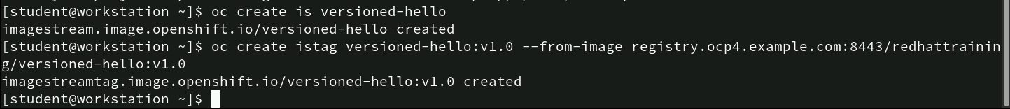
Creating an ImageStream and ImageStreamtag
oc create is versioned-hello: This command creates an ImageStream named versioned-hello.
oc create istag versioned-hello:v1.0 --from-image registry.ocp4.example.com:8443/redhattraining/versioned-hello:v1.0: This command creates an ImageStreamTag (istag) named versioned-hello:v1.0, which references an image from the specified registry.
Analysis: The user has set up an ImageStream (versioned-hello) and tagged an image (v1.0) from the registry, making it easy to manage image versions in OpenShift. This setup allows for easy version control of container images, facilitating future updates or rollbacks within the deployment pipeline.

Slide 42
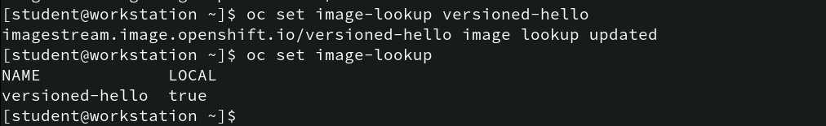
Setting Image Lookup for Image Stream
oc set image-lookup versioned-hello: This command enables image lookup for the versioned-hello ImageStream.
oc set image-lookup: This command lists the ImageStreams that have image lookup enabled.
Analysis: By enabling image lookup for versioned-hello, the user ensures that when versioned-hello is referenced in a deployment or pod, OpenShift will resolve it to the locally stored ImageStream. This provides greater control over which version of the image is used and can prevent external image pull errors if the image is updated or changed externally.

Slide 43
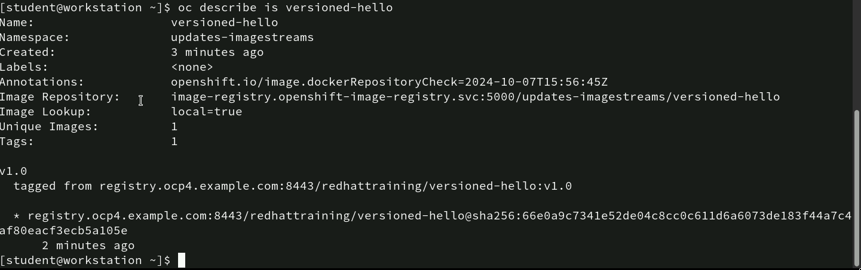
Describing the versioned-hello ImageStream
oc describe is versioned-hello: This command provides detailed information about the versioned-hello ImageStream.
Analysis: This description provides a clear overview of the versioned-hello ImageStream and its current state. The v1.0 tag is linked to an image pulled from an external registry, and local image lookup is enabled, allowing it to be referenced easily in deployments. This setup ensures control over which version of the image is used and tracks changes over time through tags and unique image identifiers.

Slide 44
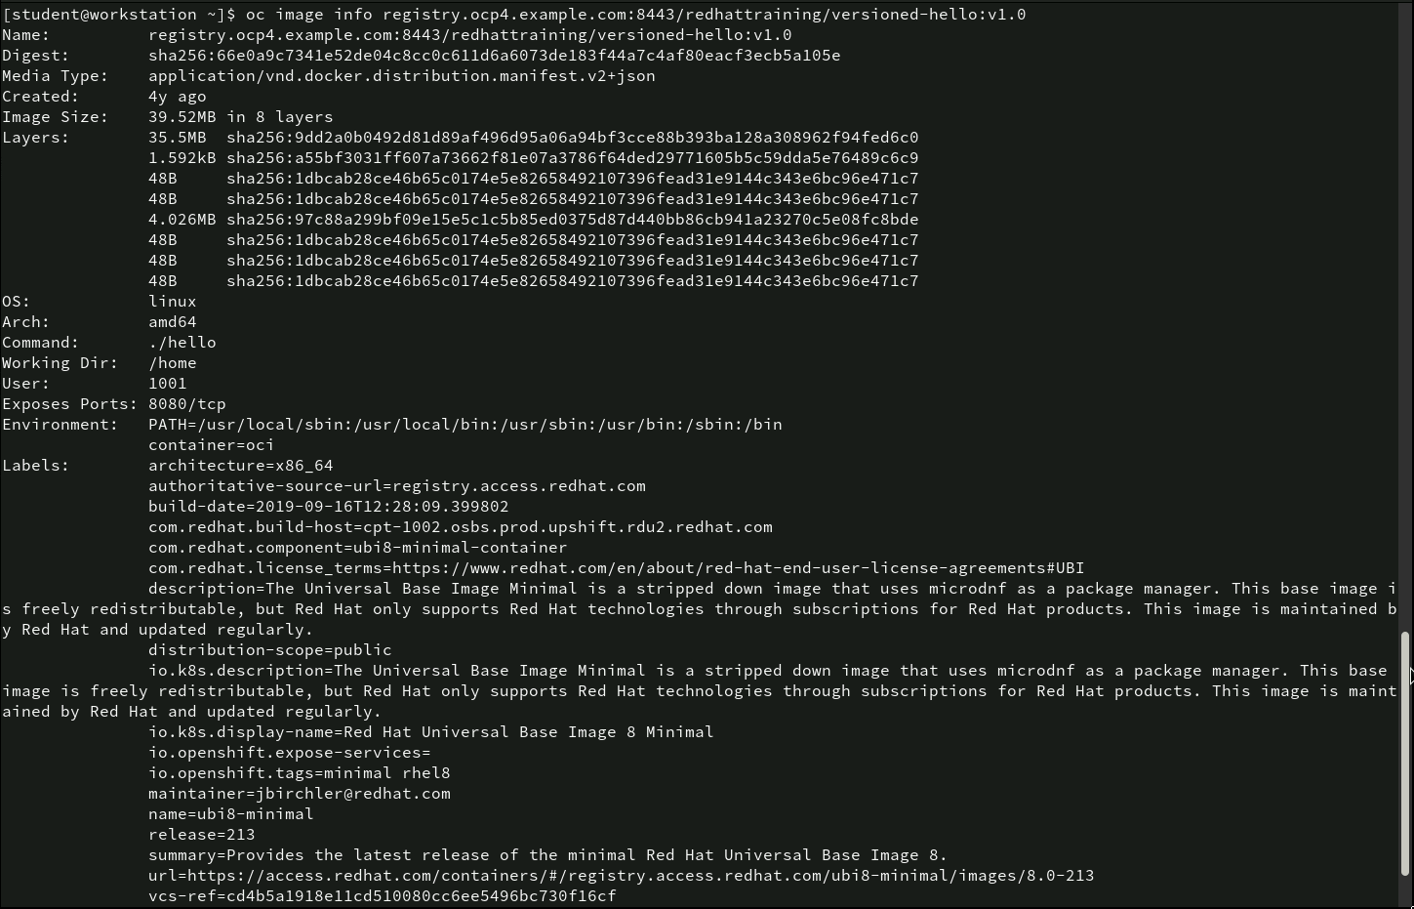
Inspecting Image Details
- oc image info registry.ocp4.example.com:8443/redhattraining/versioned-hello:v1.0: This command retrieves comprehensive details about the image versioned-hello:v1.0.

Slide 45
Image Lookup and ImageStreamTag Infromation
oc set image-lookup: This command lists the ImageStreams that have image lookup enabled.
oc get istag: This command retrieves the ImageStreamTags associated with the project.
Analysis: Enabling image lookup for versioned-hello ensures that when the image is referenced in a deployment or pod, OpenShift will resolve it to the locally stored ImageStream. The ImageStreamTag (istag) command would typically show the available tags for the versioned-hello image, helping track and manage image versions.

Slide 46
Retrieving Specific ImageStreamTag Information
- oc get istag versioned-hello:1 -o jsonpath='{.tag.from.name}{"\n"}’: This command fetches the versioned-hello:1 ImageStreamTag and outputs the value of the from.name field, which points to the image reference. This provides insight into the exact image version being used for the 1 tag.

Slide 47
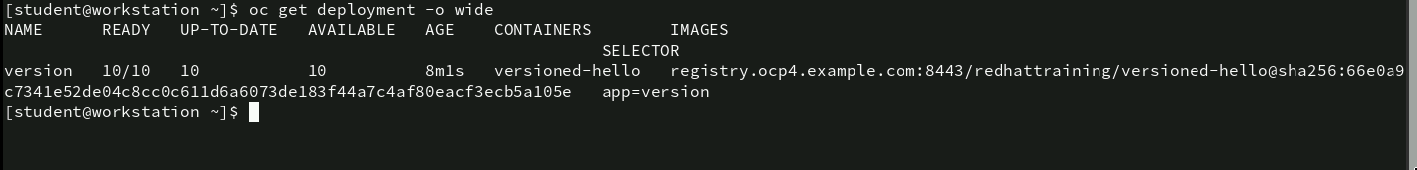
Viewing Deployment Details
oc get deployment -o wide: This command lists deployments in the current project and provides additional details such as the number of replicas, containers, images, and selectors
Analysis: The deployment is fully operational with all 10 pods up-to-date and available, confirming that the deployment is stable. The image used is tagged with a specific digest (sha256 hash), ensuring that the exact version of the image is deployed, preventing any unexpected changes in the image’s content.

Slide 48
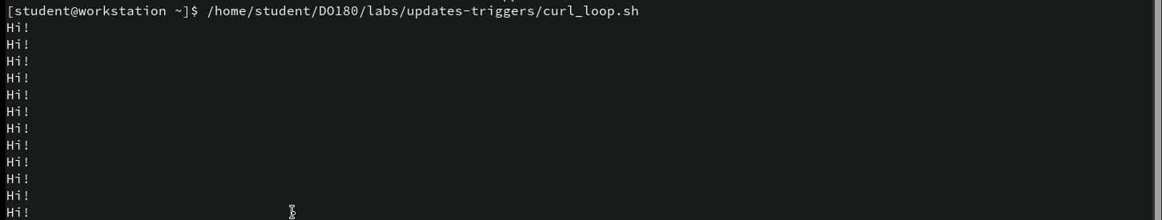
Verifying Application Response with Curl Loop Script
- home/student/D0180/labs/updates-triggers/curl_loop.sh: This script sends continuous requests to an application, and the output shows repeated “Hi!” responses from the service.

Slide 49
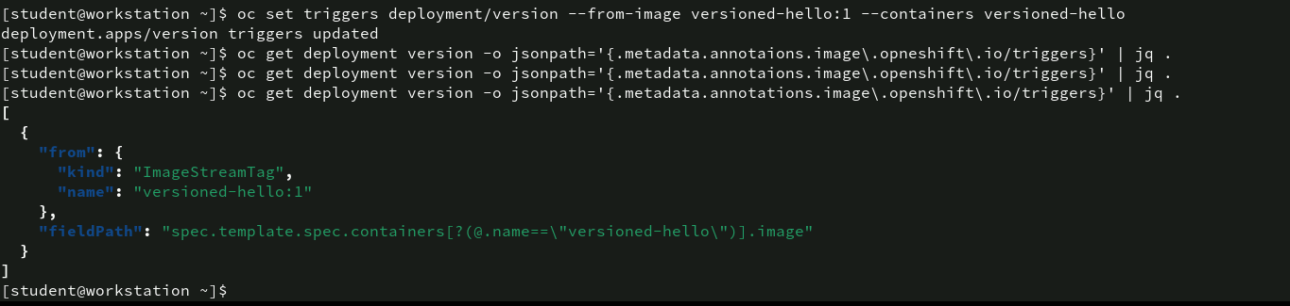
Setting Image Change Triggers for Deployment
oc set triggers deployment/version --from-image versioned-hello:1 --containers versioned-hello: This command sets an image change trigger on the version deployment, specifying that whenever the versioned-hello:1 ImageStreamTag is updated, the deployment should be updated automatically.
oc get deployment version -o jsonpath='{.metadata.annotations.image\.openshift\.io/triggers}' | jq . : This command retrieves the image change triggers set on the version deployment.
Analysis: The user has successfully set an image change trigger for the version deployment. This means that if the versioned-hello:1 image tag is updated in the ImageStream, the deployment will automatically roll out the new image, ensuring that the application always runs the latest version.

Slide 50
Tagging an Image with a New tag
oc tag registry.ocp4.example.com:8443/redhattraining/versioned-hello:1-125 versioned-hello:1: This command tags the image versioned-hello:1-125 from the external registry registry.ocp4.example.com with the local tag versioned-hello:1.
Analysis: The versioned-hello:1 tag has been updated to point to the 1-125 version of the image. Since the version deployment has an image change trigger set to automatically update when the versioned-hello:1 tag changes, this operation will likely trigger a new deployment using the updated image.

Slide 51
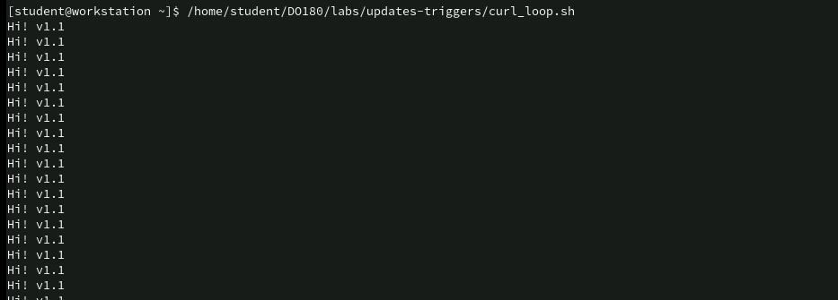
Verifying Image Update with Curl Loop Script
- /home/student/D0180/labs/updates-triggers/curl_loop.sh: This confirms that the image update was successful, as the service is now responding with “Hi! v1.1” rather than the previous message. The image tag update (versioned-hello:1) caused the deployment to roll out the new version of the image, and the curl loop script verifies that the service is running the latest version without interruption.

Slide 52
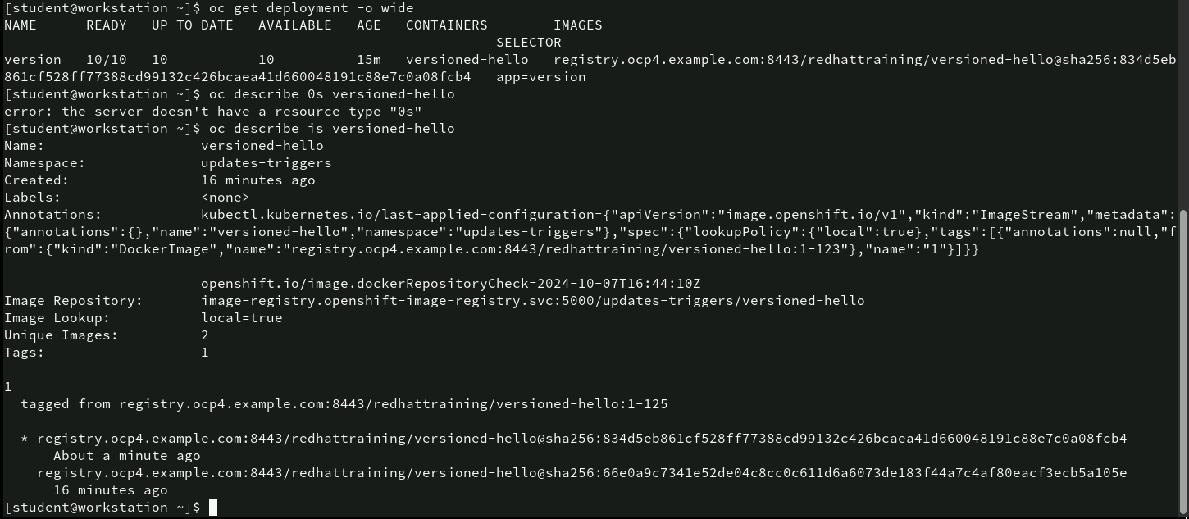
Verifying Deployment and ImageStream Details
Analysis: The deployment is running with the updated image versioned-hello:1-125, as confirmed by the deployment details. The ImageStream shows that the tag versioned-hello:1 has been correctly updated to point to the 1-125 image, and the describe command shows that two unique images have been tracked

Slide 53
Tagging a Specific Image with a new tag
oc tag registry.ocp4.example.com:8443/redhattraining/versioned-hello@sha256:66e0a9c7341e52de04c8cc0c611d6a6073de183f44a7c4af80eacf3ecb5a105e versioned-hello:1:This command sets the versioned-hello:1 tag to point to the specific image identified by the SHA-256 digest 66e0a9c7341e52de04c8cc0c611d6a6073de183f44a7c4af80eacf3ecb5a105e.
Analysis: By tagging a specific image with the SHA-256 digest, the user ensures that versioned-hello:1 now points to the exact version of the image identified by the digest. This process is useful for precise image version control, preventing any ambiguity about which image version is being deployed. This step likely triggers an update in the deployment using the versioned-hello:1 tag, reflecting the new image version.

Slide 54
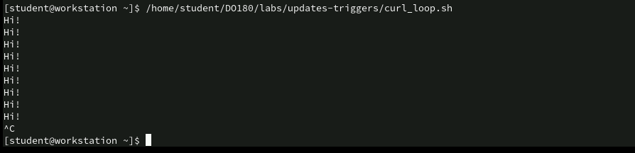
Verifying Service Response with Curl Loop Script
/home/student/D0180/labs/updates-triggers/curl_loop.sh: The output shows repeated “Hi!” responses from the service, indicating that the application is running and responding as expected.
Analysis: The service is consistently responding with “Hi!” after the image tag update, confirming that the deployment has reverted or maintained the previous version of the application (likely before the update to “Hi! v1.1”).

Slide 55
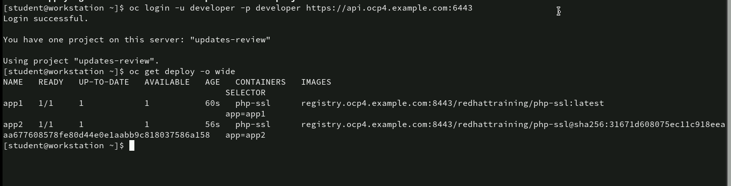
Logging into OpenShift and Viewing Deployments
oc get deploy -o wide: This command retrieves detailed information about the deployments in the updates-review project.
Analysis: Both deployments (app1 and app2) are running and fully operational, with all pods up-to-date and available. The difference between the two deployments is that app1 uses the latest tag, while app2 uses a specific image digest.

Slide 56
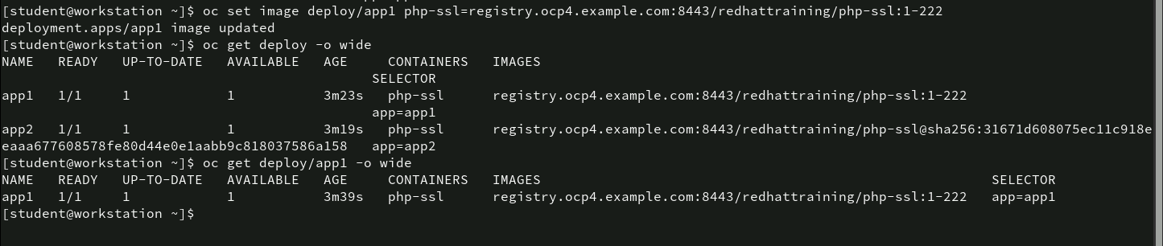
Updating Deployment Image for app1
oc set image deploy/app1 php-ssl=registry.ocp4.example.com:8443/redhattraining/php-ssl:1-222: This command updates the app1 deployment to use the image.
oc get deploy -o wide: This command retrieves detailed information about the deployments.
oc get deploy/app1 -o wide: This command retrieves detailed information about the app1 deployment specifically.

Slide 57
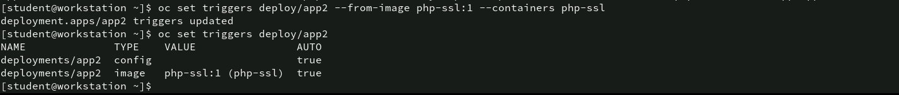
Setting Image Change triggers for Deployment app2
oc set triggers deploy/app2 --from-image php-ssl:1 --containers php-ssl: This command sets an image change trigger for the app2 deployment. The trigger is configured to automatically update the php-ssl container whenever the php-ssl:1 image tag is updated.
oc set triggers deploy/app2: This command lists the triggers set for the app2 deployment.
Analysis: The image change trigger for app2 ensures that any updates to the php-ssl:1 tag will automatically trigger a new deployment with the updated image

Slide 58
Creating an ImageStream and Setting Alias
oc create istag php-ssl:1-234 --from-image registry.ocp4.example.com:8443/redhattraining/php-ssl:1-234: This command creates an ImageStreamTag (php-ssl:1-234) by pulling the image from the specified registry.
oc tag --alias php-ssl:1-234 php-ssl:1: This command sets an alias, linking php-ssl:1 to track the php-ssl:1-234 tag.
Analysis: By creating the php-ssl:1-234 tag and setting php-ssl:1 as an alias, the user simplifies the management of image versions. Any references to php-ssl:1 will now point to php-ssl:1-234. This is useful for maintaining a common image reference (php-ssl:1) while still being able to update it to new versions (like 1-234) as needed. This helps in managing version control for images across deployments.

Slide 59
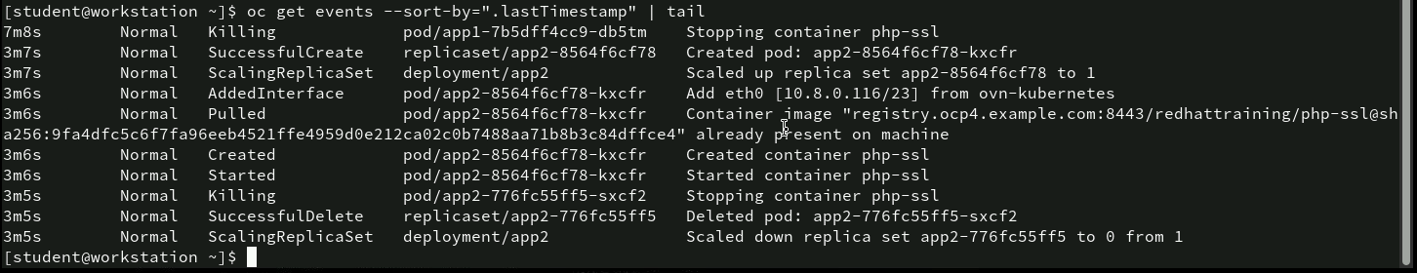
Viewing the latest OpenShift Events
- oc get events --sort-by=".lastTimestamp" | tail: This command retrieves the events in the cluster, sorted by their timestamp, and uses tail to display only the last few events.
Analysis: The most recent events show active management of the app1 and app2 deployments. Pods are being stopped, created, and started successfully. The scaling actions are completed, and the images required for the containers are already present on the nodes. This short snapshot of the events log provides insight into the recent actions and state of the applications, confirming that the cluster is responding appropriately to configuration and scaling changes.

Slide 60
Thank You!

